Slide 1
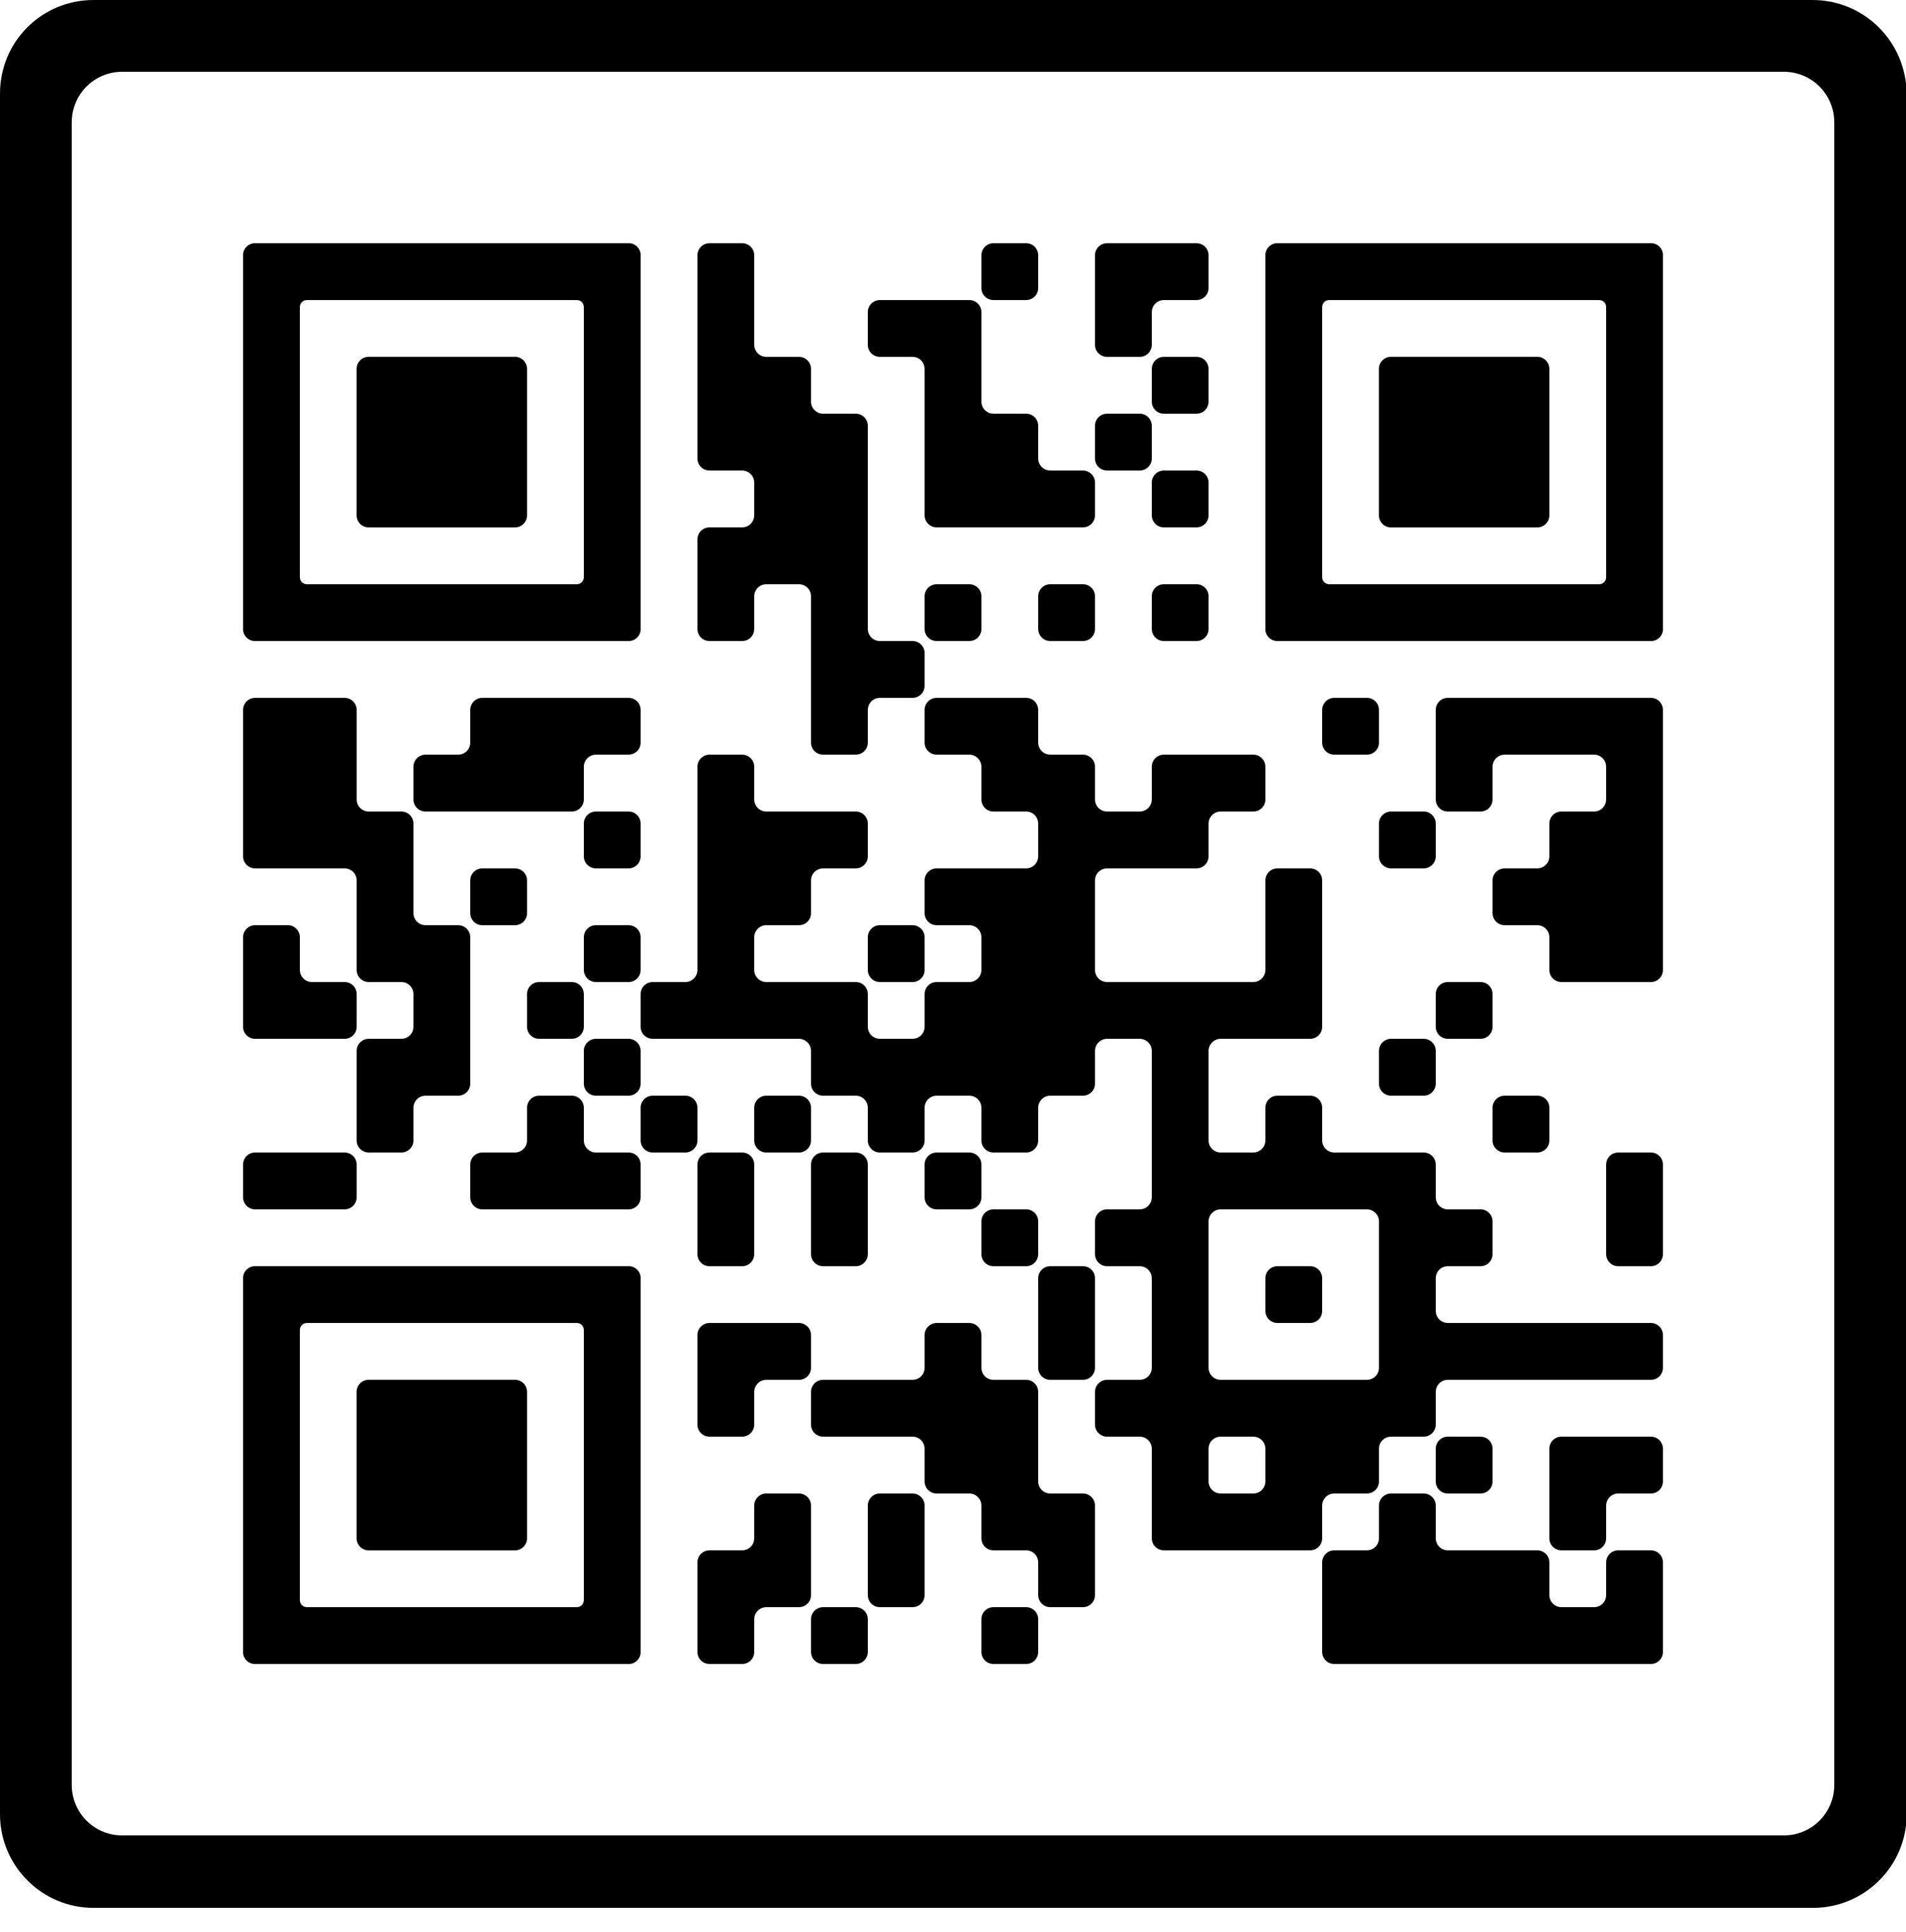
Topic: Fall Prevention
Oops A Daisy!
When you think about someone falling, what’s the first thing that comes to mind? A fall from a ladder, slipping on ice, tumbling down some stairs? Did you know that “same level falls” are the most common type of fall and can just as easily break bones, hurt your head and leave plenty of potentially embracing evidence that you had a mishap.
Resources:
Older Adult Fall Prevention: www.cdc.gov/falls
Simple Fall Prevention Tips:
www.mayoclinic.org/healthy-lifestyle/healthy-aging/in-depth/fall-prevention/art-20047358
Faith Community Health at Carle connects you and your faith community to needed healthcare and wellness support, taking a whole-person approach to health.
To learn more about bringing healthcare and wellness resources to your faith community, call (217) 902-3160 or email FaithCommunityHealth@carle.com.

